Slide 1
JAVA BOOTCAMP DAY 08
Presented by
G2Academy

Slide 2
Regular Expressions
Notes:
How presentation will benefit audience: Adult learners are more interested in a subject if they know how or why it is important to them.
Presenter’s level of expertise in the subject: Briefly state your credentials in this area, or explain why participants should listen to you.

Slide 3
Regular Expressions (Regex)
The Java Regex or Regular Expression is an API to define pattern for searching or manipulating strings.
It is widely used to define constraint on strings such as password and email validation. After learning java regex tutorial, you will be able to test your own regular expressions by the Java Regex Tester Tool.
Java Regex API provides 1 interface and 3 classes in java.util.regex package.
Notes:
Lesson descriptions should be brief.

Slide 4
java.util.regex package
It provides following classes and interface for regular expressions. The Matcher and Pattern classes are widely used in java regular expression.
MatchResult interface
Matcher class
Pattern class
PatternSyntaxException class
Notes:
Lesson descriptions should be brief.

Slide 5
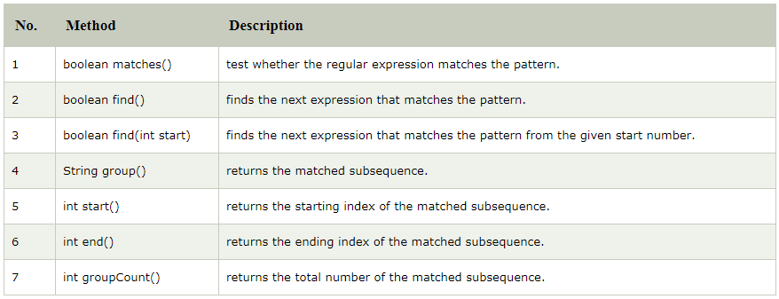
Matcher class
It implements MatchResult interface. It is a regex engine i.e. used to perform match operations on a character sequence.
Notes:
Lesson descriptions should be brief.

Slide 6
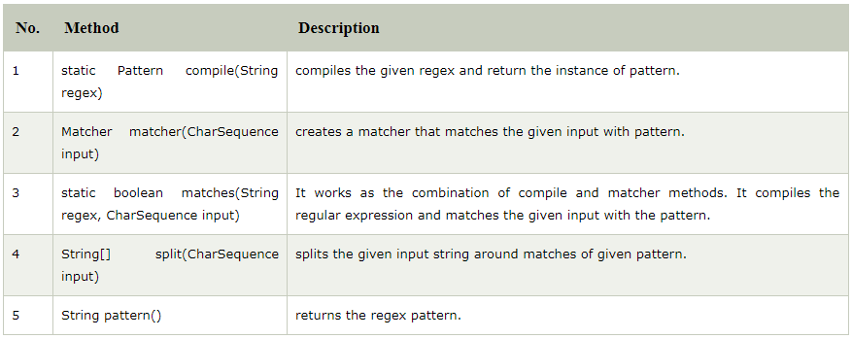
Pattern class
It is the compiled version of a regular expression. It is used to define a pattern for the regex engine.
Notes:
Lesson descriptions should be brief.

Slide 7
Regular Expressions example
import java.util.regex.*;
public class RegexExample1{
public static void main(String args[]){
//1st way
Pattern p = Pattern.compile(".s");//. represents single character
Matcher m = p.matcher("as");
boolean b = m.matches();
//2nd way
boolean b2=Pattern.compile(".s").matcher("as").matches();
//3rd way
boolean b3 = Pattern.matches(".s", "as");
System.out.println(b+" "+b2+" "+b3);
}}
Output: true true true
Notes:
Lesson descriptions should be brief.

Slide 8
Regular Expressions example
The . (dot) represents a single character.
import java.util.regex.*;
class RegexExample2{
public static void main(String args[]){
System.out.println(Pattern.matches(".s", "as"));//true (2nd char is s)
System.out.println(Pattern.matches(".s", "mk"));//false (2nd char is not s)
System.out.println(Pattern.matches(".s", "mst"));//false (has more than 2 char)
System.out.println(Pattern.matches(".s", "amms"));//false (has more than 2 char)
System.out.println(Pattern.matches("..s", "mas"));//true (3rd char is s)
}
}
Notes:
Lesson descriptions should be brief.

Slide 9
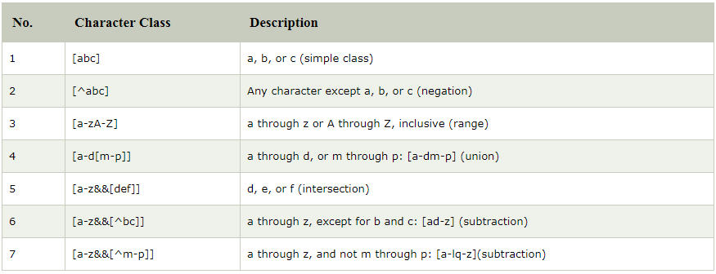
Regex Character classes
Notes:
Lesson descriptions should be brief.

Slide 10
Regex Character classes Example
import java.util.regex.*;
class RegexExample3{
public static void main(String args[]){
System.out.println(Pattern.matches("[amn]", "abcd"));//false (not a or m or n)
System.out.println(Pattern.matches("[amn]", "a"));//true (among a or m or n)
System.out.println(Pattern.matches("[amn]", "ammmna"));//false (m and a comes more than once)
}}
Notes:
Lesson descriptions should be brief.

Slide 11
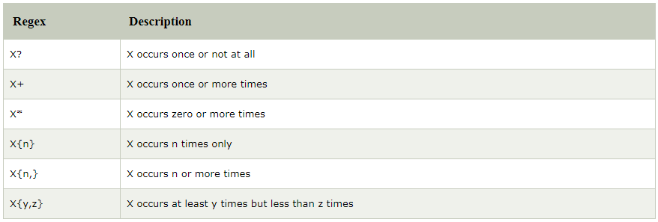
Regex Quantifiers
Notes:
Lesson descriptions should be brief.

Slide 12
Regex Character classes and Quantifiers Example
import java.util.regex.*;
class RegexExample4{
public static void main(String args[]){
System.out.println("? quantifier ....");
System.out.println(Pattern.matches("[amn]?", "a"));//true (a or m or n comes one time)
System.out.println(Pattern.matches("[amn]?", "aaa"));//false (a comes more than one time)
System.out.println(Pattern.matches("[amn]?", "aammmnn"));//false (a m and n comes more than one time)
System.out.println(Pattern.matches("[amn]?", "aazzta"));//false (a comes more than one time)
System.out.println(Pattern.matches("[amn]?", "am"));//false (a or m or n must come one time)
System.out.println("+ quantifier ....");
System.out.println(Pattern.matches("[amn]+", "a"));//true (a or m or n once or more times)
System.out.println(Pattern.matches("[amn]+", "aaa"));//true (a comes more than one time)
System.out.println(Pattern.matches("[amn]+", "aammmnn"));//true (a or m or n comes more than once)
System.out.println(Pattern.matches("[amn]+", "aazzta"));//false (z and t are not matching pattern)
System.out.println("* quantifier ....");
System.out.println(Pattern.matches("[amn]*", "ammmna"));//true (a or m or n may come zero or more times)
}}
Notes:
Lesson descriptions should be brief.

Slide 13
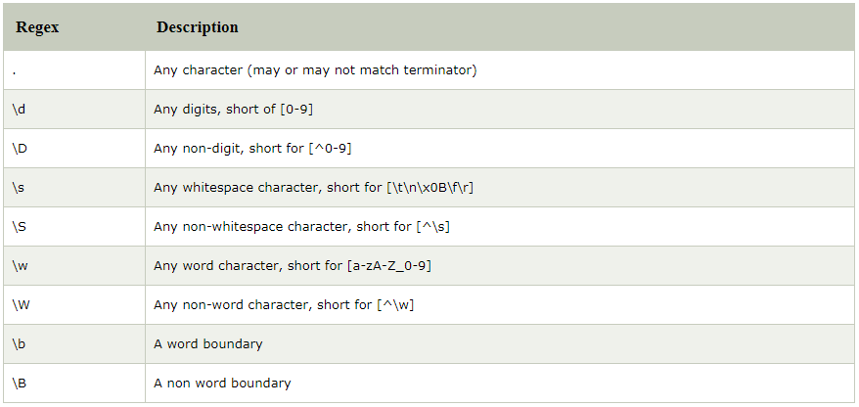
Regex Metacharacters
The regular expression metacharacters work as a short codes.
Notes:
Lesson descriptions should be brief.

Slide 14
Regex Metacharacters Example
import java.util.regex.*;
class RegexExample5{
public static void main(String args[]){
System.out.println("metacharacters d....");\\d means digit
System.out.println(Pattern.matches("\\d", "abc"));//false (non-digit)
System.out.println(Pattern.matches("\\d", "1"));//true (digit and comes once)
System.out.println(Pattern.matches("\\d", "4443"));//false (digit but comes more than once)
System.out.println(Pattern.matches("\\d", "323abc"));//false (digit and char)
System.out.println("metacharacters D....");\\D means non-digit
System.out.println(Pattern.matches("\\D", "abc"));//false (non-digit but comes more than once)
System.out.println(Pattern.matches("\\D", "1"));//false (digit)
System.out.println(Pattern.matches("\\D", "4443"));//false (digit)
System.out.println(Pattern.matches("\\D", "323abc"));//false (digit and char)
System.out.println(Pattern.matches("\\D", "m"));//true (non-digit and comes once)
System.out.println("metacharacters D with quantifier....");
System.out.println(Pattern.matches("\\D*", "mak"));//true (non-digit and may come 0 or more times)
}}
Notes:
Lesson descriptions should be brief.

Slide 15
Exception Handling
Notes:
How presentation will benefit audience: Adult learners are more interested in a subject if they know how or why it is important to them.
Presenter’s level of expertise in the subject: Briefly state your credentials in this area, or explain why participants should listen to you.

Slide 16
Exception Handling in Java
The exception handling in java is one of the powerful mechanism to handle the runtime errors so that normal flow of the application can be maintained.
In java, exception is an event that disrupts the normal flow of the program. It is an object which is thrown at runtime.
Exception Handling is a mechanism to handle runtime errors such as ClassNotFound, IO, SQL, Remote etc.
Notes:
Lesson descriptions should be brief.

Slide 17
Advantage of Exception Handling
The core advantage of exception handling is to maintain the normal flow of the application. Exception normally disrupts the normal flow of the application that is why we use exception handling. Let's take a scenario:
statement 1;
statement 2;
statement 3;
statement 4;
statement 5; //exception occurs
statement 6;
statement 7;
statement 8;
statement 9;
statement 10;
Suppose there is 10 statements in your program and there occurs an exception at statement 5, rest of the code will not be executed i.e. statement 6 to 10 will not run. If we perform exception handling, rest of the statement will be executed. That is why we use exception handling in java.
Notes:
Lesson descriptions should be brief.

Slide 18
Types of Exception
There are mainly two types of exceptions: checked and unchecked where error is considered as unchecked exception. The sun microsystem says there are three types of exceptions:
Checked Exception
The classes that extend Throwable class except RuntimeException and Error are known as checked exceptions e.g.IOException, SQLException etc. Checked exceptions are checked at compile-time.
Unchecked Exception
The classes that extend RuntimeException are known as unchecked exceptions e.g. ArithmeticException, NullPointerException, ArrayIndexOutOfBoundsException etc. Unchecked exceptions are not checked at compile-time rather they are checked at runtime.
Error
Error is irrecoverable e.g. OutOfMemoryError, VirtualMachineError, AssertionError etc.
Notes:
Lesson descriptions should be brief.

Slide 19
Common scenarios where exceptions may occur
There are given some scenarios where unchecked exceptions can occur. They are as follows:
Scenario where ArithmeticException occurs
If we divide any number by zero, there occurs an ArithmeticException.
int a=50/0;//ArithmeticException
Scenario where NullPointerException occurs
If we have null value in any variable, performing any operation by the variable occurs an NullPointerException.
String s=null;
System.out.println(s.length());//NullPointerException
Notes:
Lesson descriptions should be brief.

Slide 20
Common scenarios where exceptions may occur
Scenario where NumberFormatException occurs
The wrong formatting of any value, may occur NumberFormatException. Suppose I have a string variable that have characters, converting this variable into digit will occur NumberFormatException.
String s="abc";
int i=Integer.parseInt(s);//NumberFormatException
Scenario where ArithmeticException occurs
If you are inserting any value in the wrong index, it would result ArrayIndexOutOfBoundsException as shown below:
int a[]=new int[5];
a[10]=50; //ArrayIndexOutOfBoundsException
Notes:
Lesson descriptions should be brief.

Slide 21
Java Exception Handling Keywords
There are 5 keywords used in java exception handling.
try
catch
finally
throw
throws
Notes:
Lesson descriptions should be brief.

Slide 22
try-catch
Java try block is used to enclose the code that might throw an exception. It must be used within the method.
Java try block must be followed by either catch or finally block.
Java catch block is used to handle the Exception. It must be used after the try block only
You can use multiple catch block with a single try.
Syntax of java try-catch
try{
//code that may throw exception
}catch(Exception_class_Name ref){}
Notes:
Lesson descriptions should be brief.

Slide 23
Problem without exception handling
Let's try to understand the problem if we don't use try-catch block.
public class Testtrycatch1{
public static void main(String args[]){
int data=50/0;//may throw exception
System.out.println("rest of the code...");
}
}
Output:
Exception in thread main java.lang.ArithmeticException:/ by zero
Notes:
Lesson descriptions should be brief.

Slide 24
Problem without exception handling
As displayed in the above example, rest of the code is not executed (in such case, rest of the code... statement is not printed).
System.out.println("rest of the code...");
There can be 100 lines of code after exception. So all the code after exception will not be executed.
Notes:
Lesson descriptions should be brief.

Slide 25
Solution by exception handling
Let's see the solution of problem by java try-catch block.
public class Testtrycatch2{
public static void main(String args[]){
try{
int data=50/0;
}catch(ArithmeticException e){System.out.println(e);}
System.out.println("rest of the code...");
}
}
Output:
Exception in thread main java.lang.ArithmeticException:/ by zero
rest of the code...
Now, as displayed in the above example, rest of the code is executed i.e. rest of the code... statement is printed.
Notes:
Lesson descriptions should be brief.

Slide 26
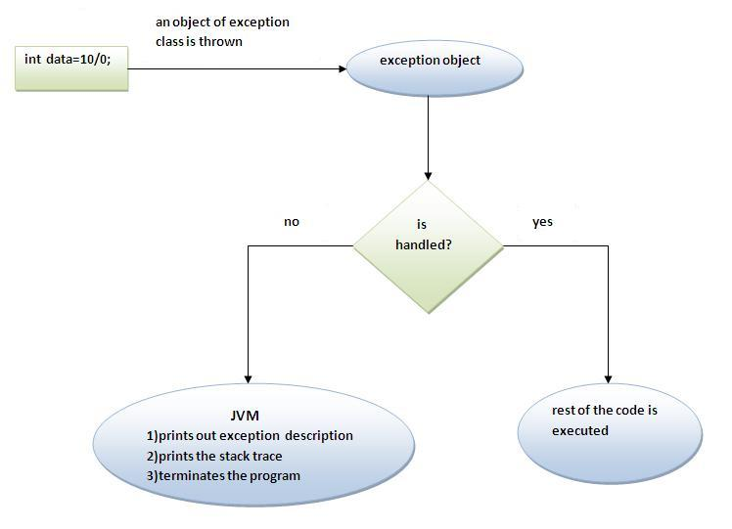
Internal working of java try-catch block
Notes:
Lesson descriptions should be brief.

Slide 27
Internal working of java try-catch block
The JVM firstly checks whether the exception is handled or not. If exception is not handled, JVM provides a default exception handler that performs the following tasks:
Prints out exception description.
Prints the stack trace (Hierarchy of methods where the exception occurred).
Causes the program to terminate.
But if exception is handled by the application programmer, normal flow of the application is maintained i.e. rest of the code is executed.
Notes:
Lesson descriptions should be brief.

Slide 28
finally block
Java finally block is a block that is used to execute important code such as closing connection, stream etc.
Java finally block is always executed whether exception is handled or not.
Java finally block follows try or catch block.
If you don't handle exception, before terminating the program, JVM executes finally block(if any).
Finally block in java can be used to put "cleanup" code such as closing a file, closing connection etc
Notes:
Lesson descriptions should be brief.

Slide 29
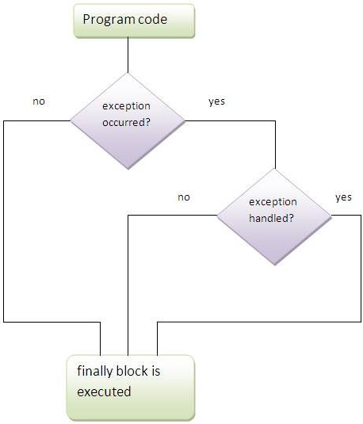
finally block
Notes:
Lesson descriptions should be brief.

Slide 30
Case 1
Let's see the java finally example where exception doesn't occur.
class TestFinallyBlock{
public static void main(String args[]){
try{
int data=25/5;
System.out.println(data);
}
catch(NullPointerException e){System.out.println(e);}
finally{System.out.println("finally block is always executed");}
System.out.println("rest of the code...");
}
}
Output:
5
finally block is always executed
rest of the code...
Notes:
Lesson descriptions should be brief.

Slide 31
Case 2
Let's see the java finally example where exception occurs and not handled.
class TestFinallyBlock1{
public static void main(String args[]){
try{
int data=25/0;
System.out.println(data);
}
catch(NullPointerException e)
{System.out.println(e);}
finally{System.out.println("finally block is always executed");}
System.out.println("rest of the code...");
}
}
Output:finally block is always executed
Exception in thread main java.lang.ArithmeticException:/ by zero
Notes:
Lesson descriptions should be brief.

Slide 32
Case 3
Let's see the java finally example where exception occurs and handled.
public class TestFinallyBlock2{
public static void main(String args[]){
try{
int data=25/0;
System.out.println(data);
}
catch(ArithmeticException e){System.out.println(e);}
finally{System.out.println("finally block is always executed");}
System.out.println("rest of the code...");
}
}
Output:Exception in thread main java.lang.ArithmeticException:/ by zero
finally block is always executed
rest of the code...
Notes:
Lesson descriptions should be brief.

Slide 33
finally block
For each try block there can be zero or more catch blocks, but only one finally block.
The finally block will not be executed if program exits(either by calling System.exit() or by causing a fatal error that causes the process to abort).
Notes:
Lesson descriptions should be brief.

Slide 34
throw exception
The Java throw keyword is used to explicitly throw an exception.
We can throw either checked or uncheked exception in java by throw keyword.
The throw keyword is mainly used to throw custom exception.
The syntax of java throw keyword is given below.
throw exception;
Let's see the example of throw IOException.
throw new IOException("sorry device error);
Notes:
Lesson descriptions should be brief.

Slide 35
throw example
In this example, we have created the validate method that takes integer value as a parameter. If the age is less than 18, we are throwing the ArithmeticException otherwise print a message welcome to vote.
public class TestThrow1{
static void validate(int age){
if(age<18)
throw new ArithmeticException("not valid");
else
System.out.println("welcome to vote");
}
public static void main(String args[]){
validate(13);
System.out.println("rest of the code...");
}
}
Output:
Exception in thread main java.lang.ArithmeticException:not valid
Notes:
Lesson descriptions should be brief.

Slide 36
throws exception
The Java throws keyword is used to declare an exception.
It gives an information to the programmer that there may occur an exception so it is better for the programmer to provide the exception handling code so that normal flow can be maintained.
Exception Handling is mainly used to handle the checked exceptions.
If there occurs any unchecked exception such as NullPointerException, it is programmers fault that he is not performing check up before the code being used.
The syntax of java throws keyword is given below.
return_type method_name() throws exception_class_name{
//method code
}
Notes:
Lesson descriptions should be brief.

Slide 37
throws exception
Which exception should be declared? checked exception only, because
unchecked Exception: under your control so correct your code.
error: beyond your control e.g. you are unable to do anything if there occurs VirtualMachineError or StackOverflowError.
Advantage of Java throws keyword
Now Checked Exception can be propagated (forwarded in call stack).
It provides information to the caller of the method about the exception.
Notes:
Lesson descriptions should be brief.

Slide 38
throws example
import java.io.IOException;
class Testthrows1{
void m()throws IOException{
throw new IOException("device error");//checked exception
}
void n()throws IOException{
m();
}
void p(){
try{
n();
}catch(Exception e){System.out.println("exception handled");}
}
public static void main(String args[]){
Testthrows1 obj=new Testthrows1();
obj.p();
System.out.println("normal flow...");
}
}
Output: exception handled
normal flow...
Notes:
Lesson descriptions should be brief.

Slide 39
throws exception
If you are calling a method that declares an exception, you must either caught or declare the exception.
Case1:You caught the exception i.e. handle the exception using try/catch.
Case2:You declare the exception i.e. specifying throws with the method.
Notes:
Lesson descriptions should be brief.

Slide 40
Case1: You handle the exception
import java.io.*;
class M{
void method()throws IOException{
throw new IOException("device error");
}
}
public class Testthrows2{
public static void main(String args[]){
try{
M m=new M();
m.method();
}catch(Exception e){System.out.println("exception handled");}
System.out.println("normal flow...");
}
}
Output: exception handled
normal flow...
Notes:
Lesson descriptions should be brief.

Slide 41
Case2: You declare the exception
In case you declare the exception, if exception does not occur, the code will be executed fine.
In case you declare the exception if exception occures, an exception will be thrown at runtime because throws does not handle the exception.
Notes:
Lesson descriptions should be brief.

Slide 42
Program if exception does not occur
import java.io.*;
class M{
void method()throws IOException{
System.out.println("device operation performed");
}
}
class Testthrows3{
public static void main(String args[])throws IOException{//declare exception
M m=new M();
m.method();
System.out.println("normal flow...");
}
}
Output: device operation performed
normal flow...
Notes:
Lesson descriptions should be brief.

Slide 43
Program if exception occurs
import java.io.*;
class M{
void method()throws IOException{
throw new IOException("device error");
}
}
class Testthrows4{
public static void main(String args[])throws IOException{//declare exception
M m=new M();
m.method();
System.out.println("normal flow...");
}
}
Output: Runtime Exception
Notes:
Lesson descriptions should be brief.

Slide 44
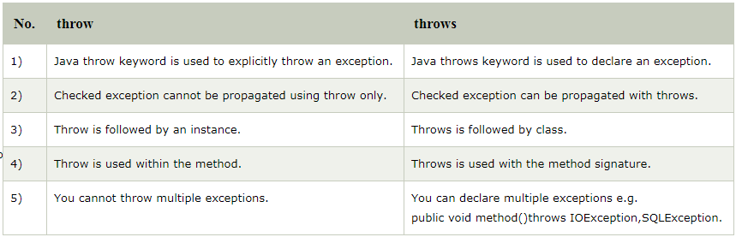
Difference between throw and throws in Java
There are many differences between throw and throws keywords. A list of differences between throw and throws are given below:
Notes:
Lesson descriptions should be brief.

Slide 45
Difference between throw and throws in Java
Java throw example
void m(){
throw new ArithmeticException("sorry");
}
Java throws example
void m()throws ArithmeticException{
//method code
}
Java throw and throws example
void m()throws ArithmeticException{
throw new ArithmeticException("sorry");
}
Notes:
Lesson descriptions should be brief.

Slide 46
